Slide 1
UNIT 1 – GRADE 9
A VISIT FROM A PEN PAL
READ

Slide 2
MATCHING THE FLAGS TO THEIR COUNTRIES
1
6
2
7
3
8
4
9
5
10

Slide 3
VOCABULARY
1.Divide (v) /dɪˈvaɪd/:
→ Divide (into something/ something into something)
Ex. The questions divide into two categories: easy and hard.
Ex. I divided the class into four groups.
→ Division (n) /dɪˈvɪʒn/:
Ex: My sister is a leader in environmental division.
→ divisive (adj) /dɪˈvaɪsɪv/:
Ex. He believes that her words are divisive.
2. Comprise (v) /kəmˈpraɪz/: be comprised of:
Ex. The collection comprises 327 paintings.
→ consist of (phr):
Ex. Their diet consisted largely of vegetables.
to separate into parts
Into separate parts
causing people to be split into groups that disagree with or oppose each other
to have somebody/something as parts or members
to be formed from the people or things mentioned

Slide 4
3.Population (n) /ˌpɒpjuˈleɪʃn/[c.n + singular or plural verb, un.n]:
Ex. The country has a total population of 65 million.
→ populate (v)/ˈpɒpjuleɪt/:
Ex. Ho Chi Minh City is heavily populated city.
Ex. The French began to populate the island in the 15th century.
4. Official (adj) /əˈfɪʃl/:
→ Officially (adv) /əˈfɪʃəli/ :
5. Religion (n) /rɪˈlɪdʒən/:
→ religious (adj) /rɪˈlɪdʒəs/ :
6. Region (n) /ˈriːdʒən/:
Ex. The plant is found throughout the western region of the country.
→ regional (adj) /ˈriːdʒənl/:
Ex. My brother is working for a regional newspaper.
the total number of people who live there
to live in an area and form its population, inhabit /ɪnˈhæbɪt/
to move people or animals to an area to live there
[usually before noun] agreed to, said, done, etc. by somebody who is in a position of authority
publicly and by somebody who is in a position of authority
[uncountable] the belief in the existence of a god or gods, and the activities that are connected with the worship of them, or in the teachings of a spiritual leader
[only before noun] connected with religion or with a particular religion
a large area of land, usually without exact limits or borders
of or relating to a region

Slide 5
7. Instruction (n) /ɪnˈstrʌkʃn/
→ instructions (n) from somebody/to somebody/ on doing something:
→ instruction (u.n):
Ex. His instructions to his staff were very clear.
She had no formal instruction in music.
→ instruct (v)/ɪnˈstrʌkt/:
Ex. The letter instructed him to report to headquarters immediately.
Ex. All our staff have been instructed in sign language.
→ instructional (adj) /ɪnˈstrʌkʃənl/:
8. Compulsory (adj) /kəmˈpʌlsəri/:
Ex. English is a compulsory subject at this level.
→ compulsion (n) /kəmˈpʌlʃn/:
Ex. For many people, dieting is a compulsion.
→ compel (v) /kəmˈpel/:
Ex. Last year ill health compelled his retirement.
detailed information on how to do or use
something
the act of teaching something to somebody
to tell somebody to do something, especially in a formal or official way
to teach somebody something, especially a practical skill
that teaches people something
that must be done because of a law or a rule
strong pressure that makes somebody do something that they do not want to do
to force somebody to do something; to make something necessary

Slide 6
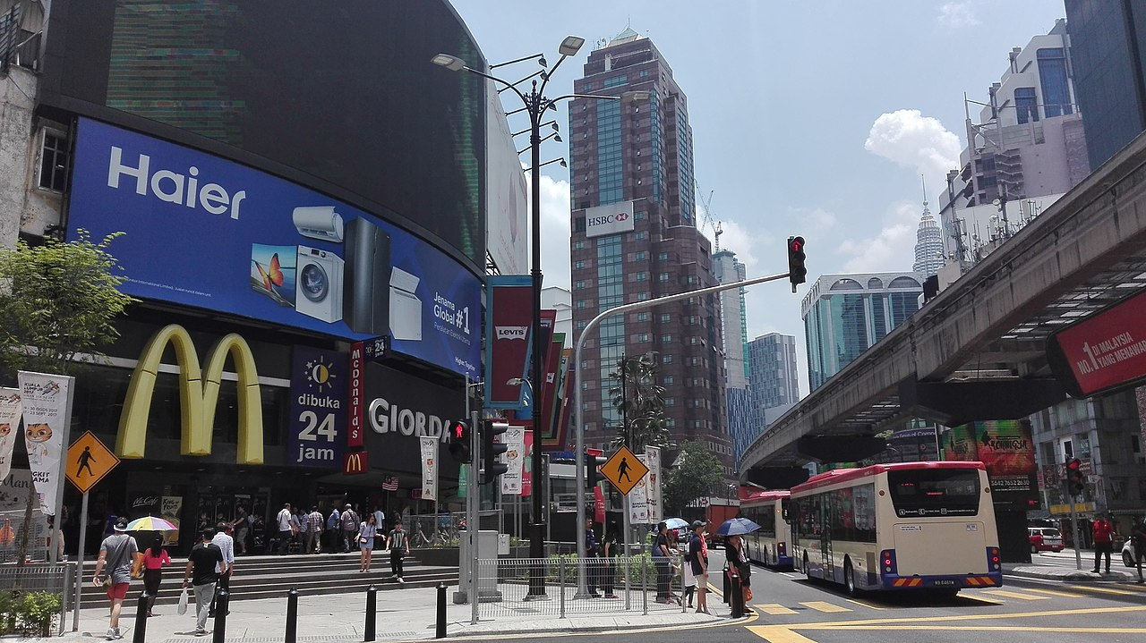
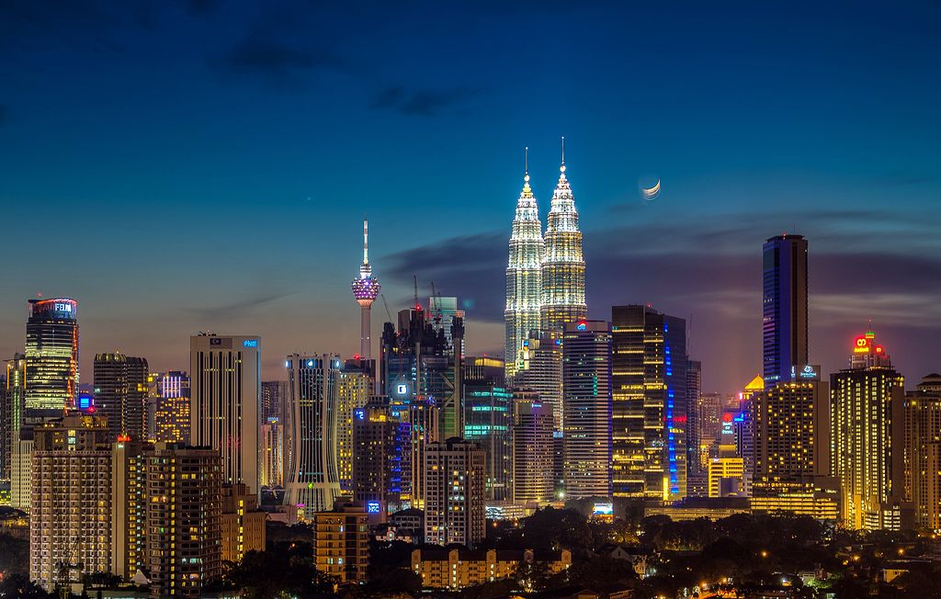
READ THE TEXT AND FILL IN THE TABLE WITH THE RIGHT INFORMATION ABOUT MALAYSIA.
MALAYSIA
Malaysia is one of the countries of the Association of South East Asian Nations (ASEAN). It is divided into two regions, known as West Malaysia and East Malaysia. They are separated by about 640 km of the sea and together comprise an area of 329,758 sq km. Malaysia enjoys tropical climate. The Malaysian unit of currency is the ringgit, consisting of 100 sen.
The capital of Malaysia is Kuala Lumpur and it is also the largest city in the country. The population in 2001 was over 22 million. Islam is the country’s official religion. In addition, there are other religions such as Buddhism and Hinduism. The national language is Bahasa Malaysia (also known simply as Malay). English, Chinese, and Tamil are also widely spoken. The language of instruction for primary school children is Bahasa Malaysia, Chinese, or Tamel. Bahasa Malaysia is the primary language of instruction in all secondary schools, although some students may continue learning in Chinese or Tamel. And English is a compulsory second language.
329,758 sq km
Area: ………………………………………
Population: ……………………………………..
Climate : …………………………………….
Unit of currency: ……………………………………………….…
Capital city: …………………………………………….……
Official religion: …………………………………………….…...
National language: ……………………………………….……….…
Compulsory second language:
…………………………………………………..
In 2001 over 22 million
Tropical climate
Ringgit (consisting of 100 sen)
Kuala Lumpur
Islam
Bahasa Malaysia
English

Slide 7
True or False ? Check the boxes. Then correct the false statement.
MALAYSIA
Malaysia is one of the countries of the Association of South East Asian Nations (ASEAN). It is divided into two regions, known as West Malaysia and East Malaysia. They are separated by about 640 km of the sea and together comprise an area of 329,758 sq km. Malaysia enjoys tropical climate. The Malaysian unit of currency is the ringgit, consisting of 100 sen.
The capital of Malaysia is Kuala Lumpur and it is also the largest city in the country. The population in 2001 was over 22 million. Islam is the country’s official religion. In addition, there are other religions such as Buddhism and Hinduism. The national language is Bahasa Malaysia (also known simply as Malay). English, Chinese, and Tamil are also widely spoken. The language of instruction for primary school children is Bahasa Malaysia, Chinese, or Tamel. Bahasa Malaysia is the primary language of instruction in all secondary schools, although some students may continue learning in Chinese or Tamel. And English is a compulsory second language
T
F
Malaysia is a member country of Asean.
……………………………………………………………………….
2. There are two religions in Malaysia.
…………..………………………………………………………….
……………………………………………………………………...
3. People speak only Malay in Malaysia.
…………………….………………………………………………..
………………………………………………………………………
4. Primary school children learn three
languages at school.
………………………………………………………………………
…………………………………………………………………......
All secondary school children learn
in English.
……………………………………………………………………….
……………………………………………………………………….
There are more than two religions.
English, Chinese, and Tamil are also
widely spoken.
One of the three: Malay, Chinese, Tamil
English is a compulsory second language, not primary language of instruction.

Slide 8
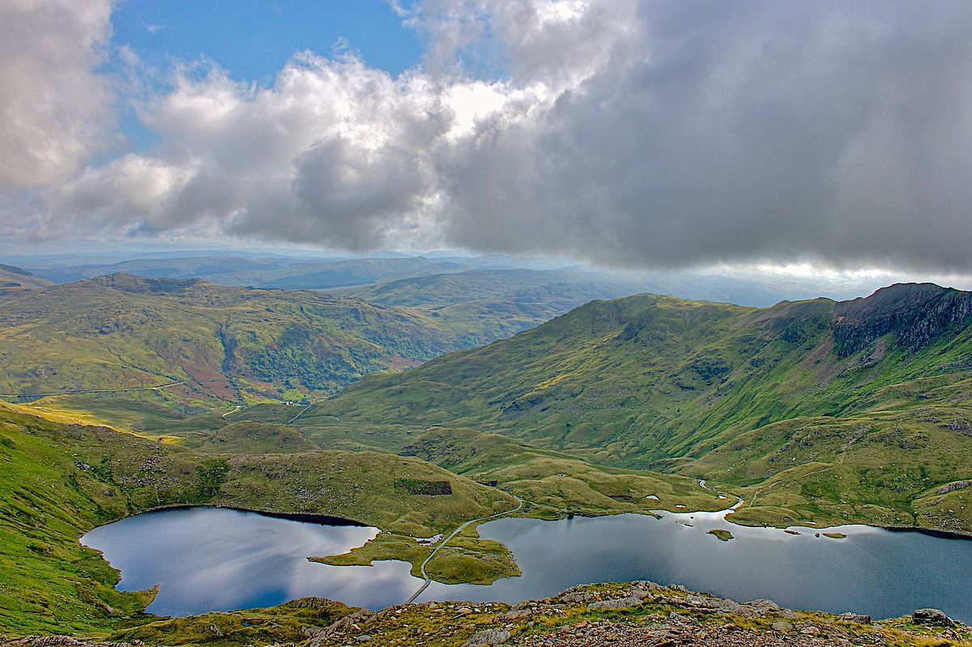
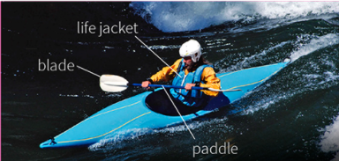
READ THE TEXT AND GIVE INFORMATION ABOUT WALES
NORTH WALES
Wales isn’t an independent state- it is part of the UK. It is situated in the west of Britain. It has a population of about three million and the capital is Cardiff. Most of the population live in the industrial south of the country.
The north of Wales is one of the most beautiful parts of Britain. There are spectacular lakes, valleys and rivers. There are also wonderful mountains –including Snowdon, Britain’s second –highest mountain.
Two languages are spoken in Wales : English and Welsh. Welsh is a Celtic language and is one of the oldest languages in Europe. Only 20% of the total population of Wales speak Welsh , but in the small villages and towns of west and north Wales, about 75% of people speak it as their first language.
The two main industries in the north are tourism and farming. Many people came to walk and climb in the mountains or go kayaking on the rivers. There are lots of sheep farms in the hills, but it is difficult to make money from sheep farming, and many farms are closing. Young people have difficulty finding jobs in north Wales and many of them are leaving to get jobs in the city.
POLITICAL STATUS (TÌNH TRẠNG CHÍNH TRỊ): ……………………………….............................
………………………………………………………….
2. CAPITAL : ……………………………………………
3. POPULATION IN WALES:
……..……………….………………………………….
LANGUAGES :
……………………………………………………………
INDUSTRY (NGÀNH DỊCH VỤ):
……………………………………….…………………..
………………………………………………………......
LANDSCAPE (PHONG CẢNH) :
……………………………………………………………
…………………………………………………............
A DEPENDENT STATE – A PART OF THE UK
CARDIFF
ABOUT THREE MILLION
ENGLISH AND WELSH
INDUSTRY IN SOUTH, FARMING, AND TOURISM IN NORTH
LAKES , VALLEYS, RIVERS AND MOUNTAINS IN NORTH WALES
KAYAK
SNOWDON

Slide 9
HOMEWORK
Make 5 true or false sentences about Wales.
Give 5 examples with the words you have learned.
Reread the text.

